Slide 1

Big Data & Analytics Final Project
Sandro Megrelishvili Mn: 39851214
Hadi Karroum Mn: 48387598

Slide 2
Requirements
Collect/Describe the requirements:
1. The system should store information about films, including their title, release date, IMDb rating, associated genres, directors, and actors. 2. Each film can have multiple directors, and actors, and each genre, director, and actor can be associated with multiple films. 3. Actors may have a date of birth recorded.
Business rules/requirements: 1. Each film must have at least one genre, one director, and one actor associated with it.
2. An actor can play multiple roles in a film.
3. Films should have unique identifiers (FilmID). 4. Genres, actors, and directors should have unique identifiers (GenreID, ActorID, DirectorID).

Slide 3
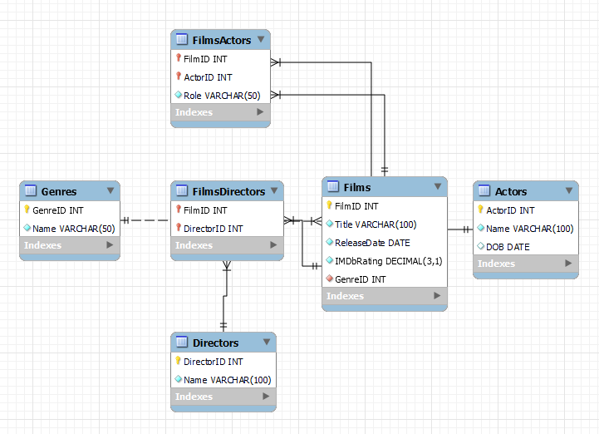
ERD

Slide 4
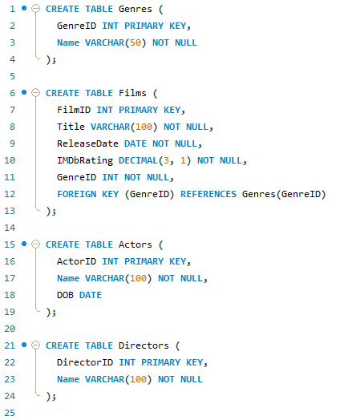
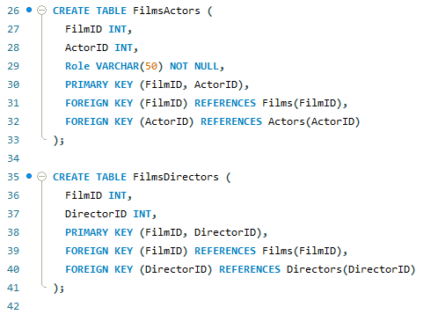
Convert ERD to SQL tables

Slide 5
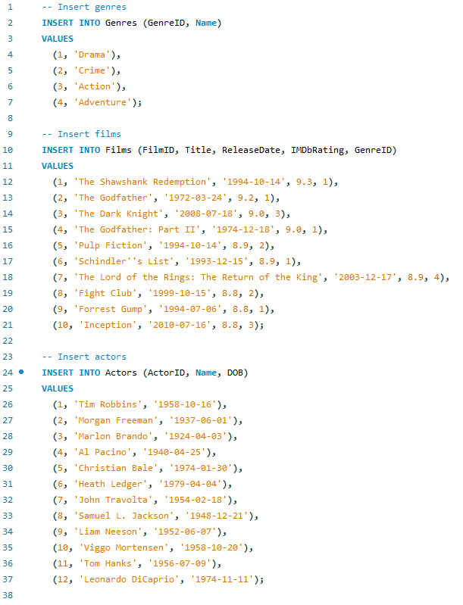
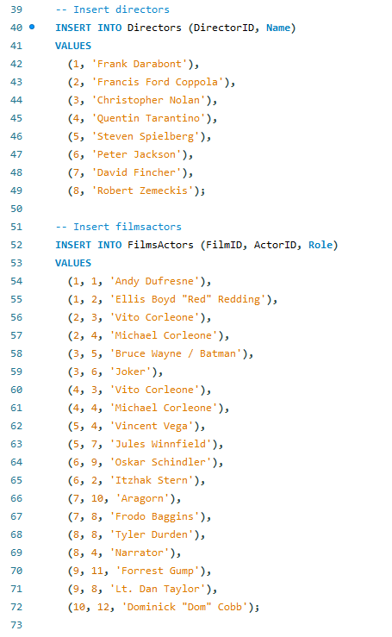
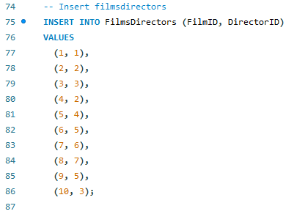
Inserting Data

Slide 6
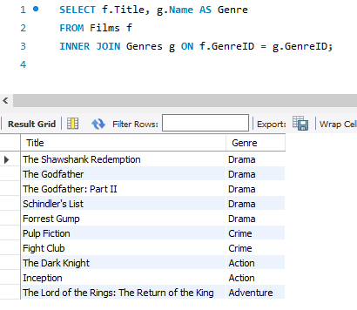
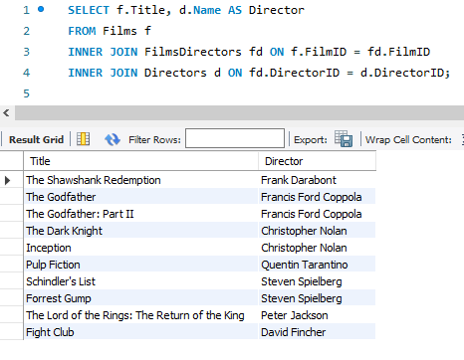
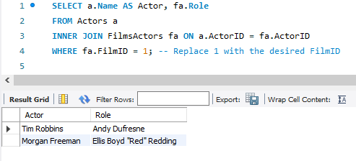
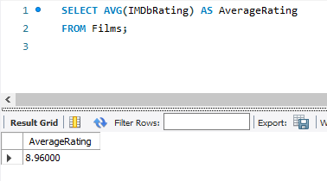
Run queries

Slide 7
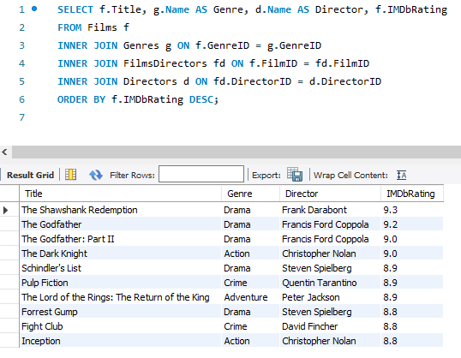
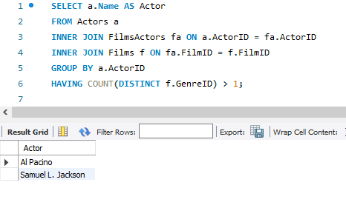
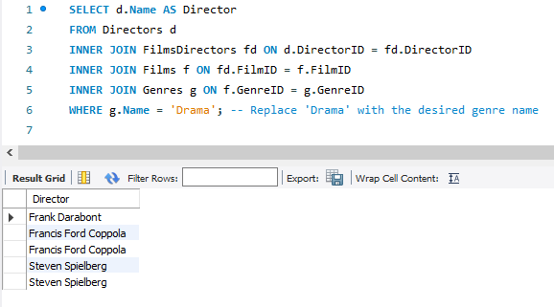
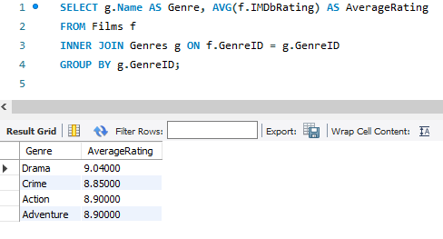
Run queries

Slide 8
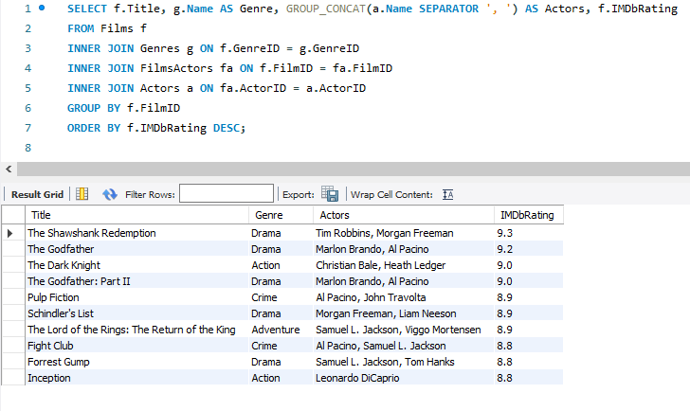
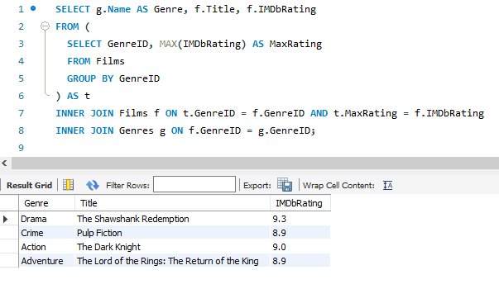
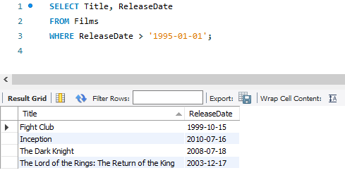
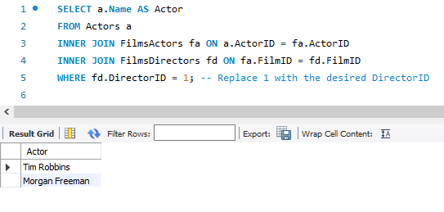
Run queries

Slide 9
Thank you for your attention
Sandro Megrelishvili Mn: 39851214 Email: sandro.megrelishvili@ue-germany.de
Hadi Karroum Mn: 48387598 Email: hadi.karroum@ue-germany.de

